Slide 1


Slide 2

It is a cancer of the female reproductive tract
It is the most common cause of cancer death in the world where Pap tests are not available
It is the easiest gynecologic cancer to prevent through screening and early vaccination

Slide 3

Squamo columnar junction(Two cell types present (squamous and glandular or columnar)
Cervical erosion under oestrogen influence
Exposed columnar epithelium undergo metaplasia
High cellular activity : mitosis
Transformation zone

Slide 4
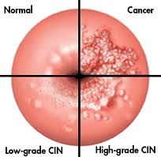
Begins in the TZ
Cells change from normal to pre-cancer (dysplasia) and then to cancer

Slide 5

The central cause of cervical cancer is human papillomavirus or HPV: chronic infection
  HPV is transmitted through sexual contact
  The HPV detected today could have been acquired years ago : average time 7-10years
  There are many different types of HPV that can infect the cervix, vagina and vulva
    ‘Low-risk’ types may cause genital warts 6,11
    ‘High-risk’ types may cause precancer and cancer of the cervix : 16 ,18, 31, 33
  Most women who are infected with HPV will never have any symptoms

Slide 6

Women who have ever had sex
Women who have had more than one partner
Women whose partner (s) has had more than one sexual partner
Women who have had a sexually-transmitted disease

Slide 7
Women who do not have Pap tests
Women with immune problems including those who:
  Use steroid medications on a regular basis
  Have organ transplant
  Are undergoing chemotherapy
  Are infected with HIV
Women who smoke.
  Smoking all by itself increases the risk of HPV infection and cervical precancer lesions, and doubles the risk of getting cervical cancer

Slide 8

Cervical smear (PAP)
Liquid based cytology LBC
Automated PAP smear testing
HPV testing
Visual inspection methods VIA VILI

Slide 9

A test which collects cells from the surface of the cervix and looks for any abnormal cells
Abnormal cells can be treated before cervical cancer develops
When cancer is detected early, it is easier to treat

Slide 10
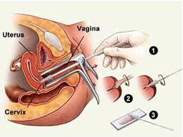
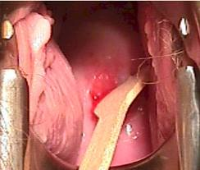
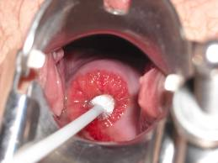

Slide 11
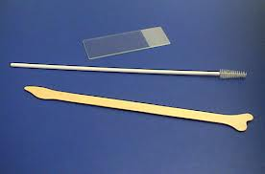
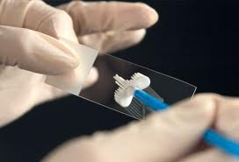


Slide 12
At age 21, regardless of sexual activity history
35 years to 65 years
Oppertunistic testing

Slide 13

Every 2 years for women aged 21-29
Women aged 30 years and older who have had three consecutive Pap smear results that are negative can be screened at intervals of every 3 years.
  Additionally women aged 30 and older, who have a negative Pap smear and negative HPV testing, can be screened every 3 years with repeat Pap smear and HPV testing.

Slide 14

Schedule Pap when not having menstrual period.
It is best to abstain from intercourse, and avoid use of tampons or douches for 2 days before your Pap test.

Slide 15

hysterectomy for a non-cancer disease, may not need a Pap test.
If treated for precancerous or cancer of the cervix, may need a Pap test
Subtotal hysterectomy may need PAP
Preventive health care is still important even if Pap test is not needed

Slide 16

  HPV testing
  Repeat Pap
  Colposcopy
  Possibly an endometrial biopsy
  Possible referral to gynecologic oncologist

Slide 17
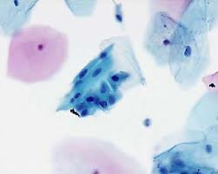
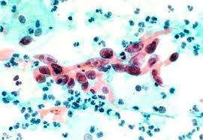
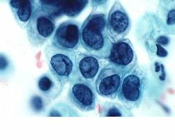
Squamous metaplasia
High grade lesion

Slide 18

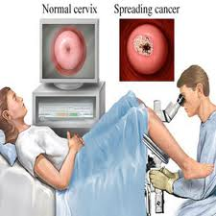
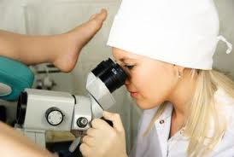
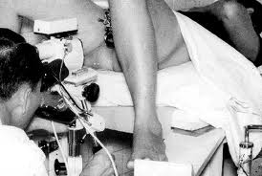
Colposcopy:
Use of a magnifying instrument
Application of 2-5% acetic acid onto the cervix
Shows abnormalities that can’t be seen with the naked eye
Feels like getting a Pap test, but takes a longer time

Slide 19

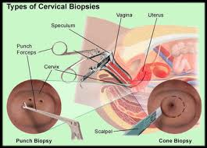

Biopsy:
Punch biopsy from the cervix
Full thickness including basement membrane
May feel like getting a Pap test or like a menstrual cramp that lasts a few seconds

Slide 20

(CIN I)
  Usually watched closely , may regress
  (CIN II)
  Usuall scheduled for treatment or watched closely
(CIN III)
  Usually requires office or outpatient treatment
Cancer
  Usually followed by a consultation with a gynecologic oncologist

Slide 21
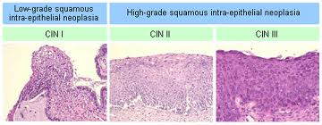
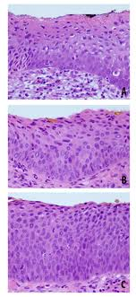
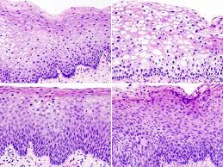
CIN I
CIN II
CIN III

Slide 22

There are a variety of effective options for treatment. Most are outpatient or office treatments. Treatment names that you might hear include:
  LEEP/ LLETZ
  Laser
  Cryotherapy
  Cone Biopsy
  Rarely, a hysterectomy may be recommended

Slide 23

Estimates of cure range from 73-90% with a single treatment
The risk for invasive cancer following treatment is about 1%
need to have regular Pap tests
Minimal impact on fertility

Slide 24

The cervical cancer vaccine (also known as the Human Papillomavirus or HPV vaccine) will help prevent cervical cancer by providing protection from the ‘high-risk’ HPV virus types that cause 70% of cervical cancer
before initial sexual contact
The benefit of the vaccine declines with increased HPV exposure

Slide 25
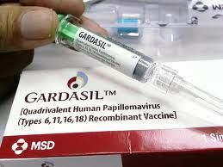
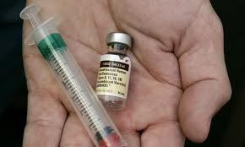
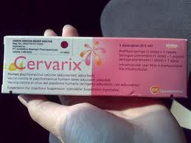


Slide 26







The FDA has recommended the following groups of women get vaccinated:
  Girls 11–12: Recommended Age Group (can be started as young as age 9).
  Women 13–26: the benefit of the vaccine may be lower depending on prior HPV exposure.

Slide 27

If you are a female between the ages of 11 and 12 the vaccine has proven benefit for you
If you started having sex, you can still get the vaccine, but the benefit from the vaccine may be lower because you may have already been exposed to HPV
The vaccine does not work to eliminate current HPV infections
The vaccine only prevents certain types of HPV infection
Early vaccination, regular Pap tests and HPV tests when recommended by a healthcare provider will provide you with your best protection against cervical cancer

Slide 28

You will need a series of three appointments over 6 months
You will receive a shot, usually in the upper arm, at each of the three appointments
Common side effects include:
  A sore arm for a day or two after the vaccine shot
  A headache and/or a low grade fever
You can use over the counter pain and fever medications if needed
You should not get the vaccine if you are pregnant or trying to get pregnant

Slide 29


Slide 30

Abnormal bleeding
  Between periods
  With intercourse
  After menopause
Unusual vaginal discharge
Other symptoms
  Leg pain
  Pelvic pain
  Bleeding from the rectum or bladder
Some women have no symptoms

Slide 31

  Conization
  Hysterectomy
  Radical trachelectomy
  Radical hysterectomy
  Radiation with chemotherapy
Other considerations
  Preserve your fertility
  Preserve your ovaries

Slide 32

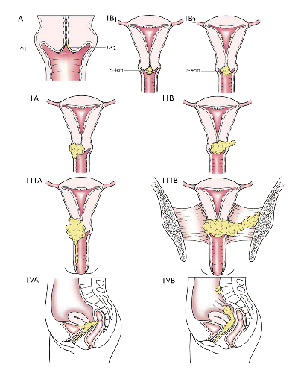

Slide 33

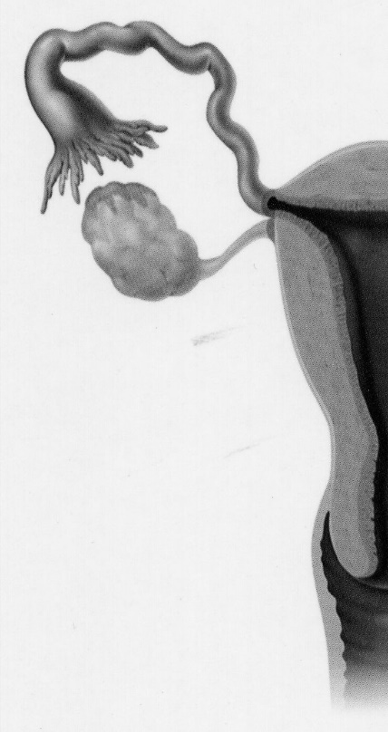
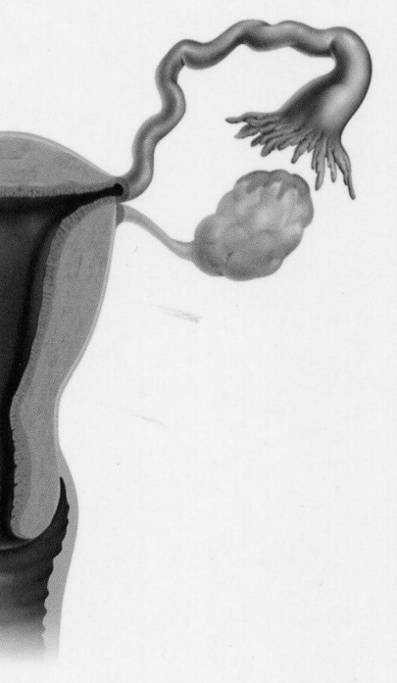
Conization:
  Removes a cone-shaped piece of tissue
  Often allows for diagnosis and treatment
  Performed with local anesthesia in the office or under general anesthesia in the operating room

Slide 34

Treatment option for early stage cancer 1 and 2A
Not the same as the usual hysterectomy
Surgical removal of the uterus, cervix and upper vagina with the surrounding tissues
Pelvic Lymph nodes
Removal of the ovaries is not required

Slide 35

A possible treatment option for certain types of early stage cancer
Surgical removal of the cervix and upper vagina with the surrounding tissues. The uterine body (womb) remains inside you.
Lymph nodes are removed
Removal of the ovaries is not required
Not an appropriate treatment option for everyone with early stage cervical cancer

Slide 36

Standard of care for advanced cancer
Treatment requires:
  External radiation
  Internal radiation
  Low dose chemotherapy given at the same time

Slide 37
Delay onset of sexual activity or remain abstinent
Know your sexual partner
Do not smoke
Maintain a healthy diet and lifestyle
Practice safe sex. Condoms decrease the chance of HPV exposure.
If eligible, consider getting the vaccine that prevents most cervical cancers.
Get your Pap test and HPV testing as recommended by your health care provider.

Slide 38

Low grade squamous intra epithelial lesion
High grade squamous intra epithelial lesion

Slide 43

Take Control - Protect Yourself
1) Ask your doctor about an appropriate Pap test screening interval for you
2) Make sure that you get a Pap test at the recommended time
3) Find out how and when you will learn about the results of your Pap test
4) Follow-up! Don’t assume that no news is
good news
5) Do not smoke

Slide 44


